Slide 1
PHYS60022 Data Science and Machine Learning for Physics
Week 1: Discussion
Spring 2025

Slide 2
Variance & Standard Errors
In your 1st year statistics course, you will have learned about standard errors and error propagation
Eg – If you make two independent measurements X and Y with uncertainties σ_{X} and σ_{Y} what is the uncertainty on X+Y?

Slide 3
Variance & Standard Errors
In your 1st year statistics course, you will have learned about standard errors and error propagation
Eg – If you make two independent measurements X and Y with uncertainties σ_{X} and σ_{Y} what is the uncertainty on X+Y?
The typical formula is
Where does this come from ? What is it really saying?

Slide 4
Variance & Standard Errors
This comes from an interpretation of “uncertainty” (often wrongly called error) being equal to the standard deviation of the distribution of the random variable U = X+Y
“If X and Y are continuous random variables distributed as Gaussian distributions with standard” deviation σ_{X} and σ_{Y} then the random variable U = X+Y will be distributed as a Gaussian distribution with standard deviation σ_{X+Y} given above”

Slide 5
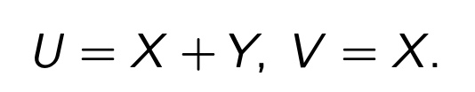

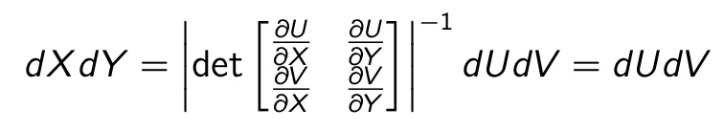
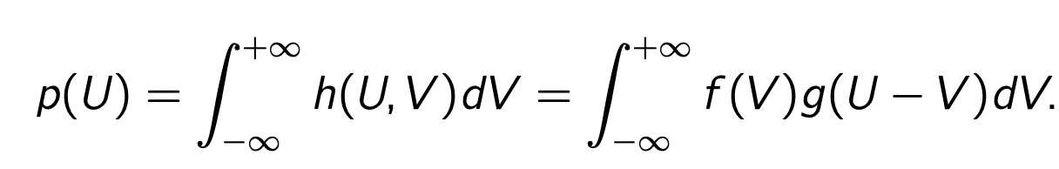
Proof of that
Define
Joint distribution
Marginal distribution
where
So we just need to solve

Slide 6
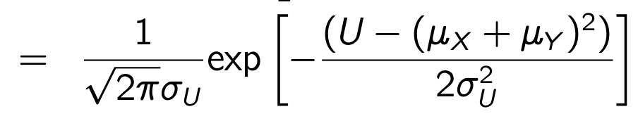

Proof of that
Define
Joint distribution
Marginal distribution
where
So we just need to solve
You will find (after a lot of algebra)
with
So U is indeed Gaussian distributed and the variance is as expected!

Slide 7
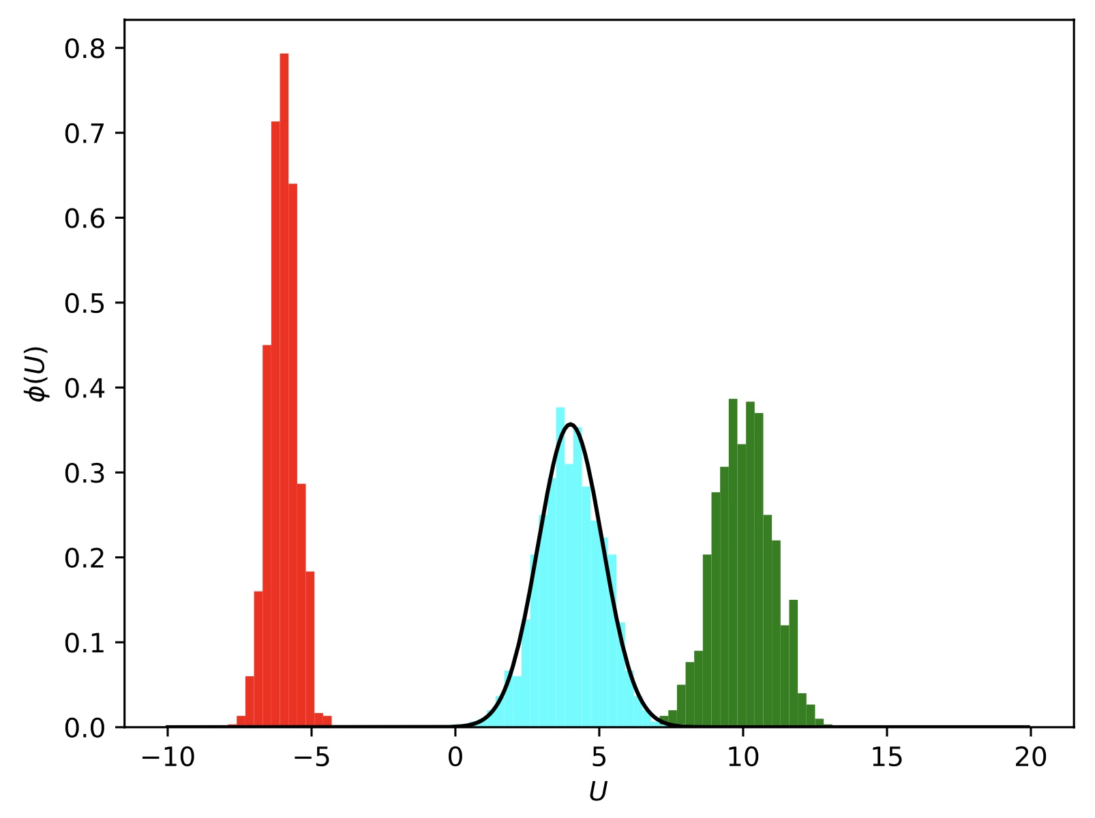
Check in simulation
Random samples of X
Random samples of Y
X+Y

Slide 8
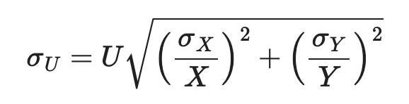
What about other simple combinations of X and Y?
What if X and Y are standard normal distributions? What is the uncertainty of U = X/Y ?
?

Slide 9
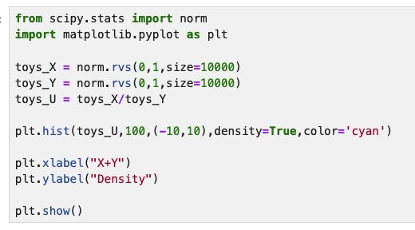
What about other simple combinations of X and Y?
What if X and Y are standard normal distributions? What is the uncertainty of U = X/Y ?

Slide 10
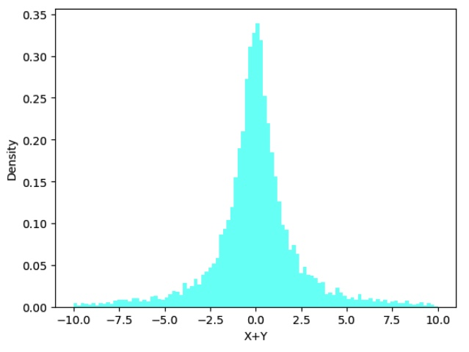
What about other simple combinations of X and Y?
What if X and Y are standard normal distributions? What is the uncertainty of U = X/Y ?

Slide 11
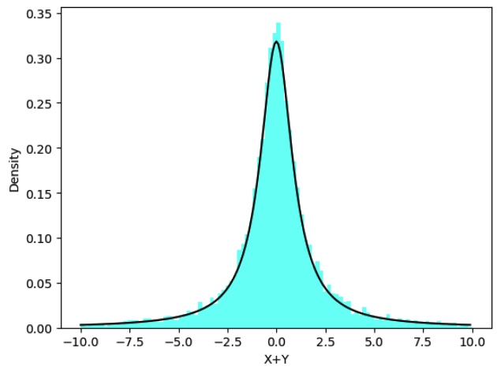

What about other simple combinations of X and Y?
What if X and Y are standard normal distributions? What is the uncertainty of U = X/Y ?
Can show that a Cauchy distribution!
This distribution has undefined mean and infinite variance!

